Slide 1
Lecture 2
Probability Review

Slide 2
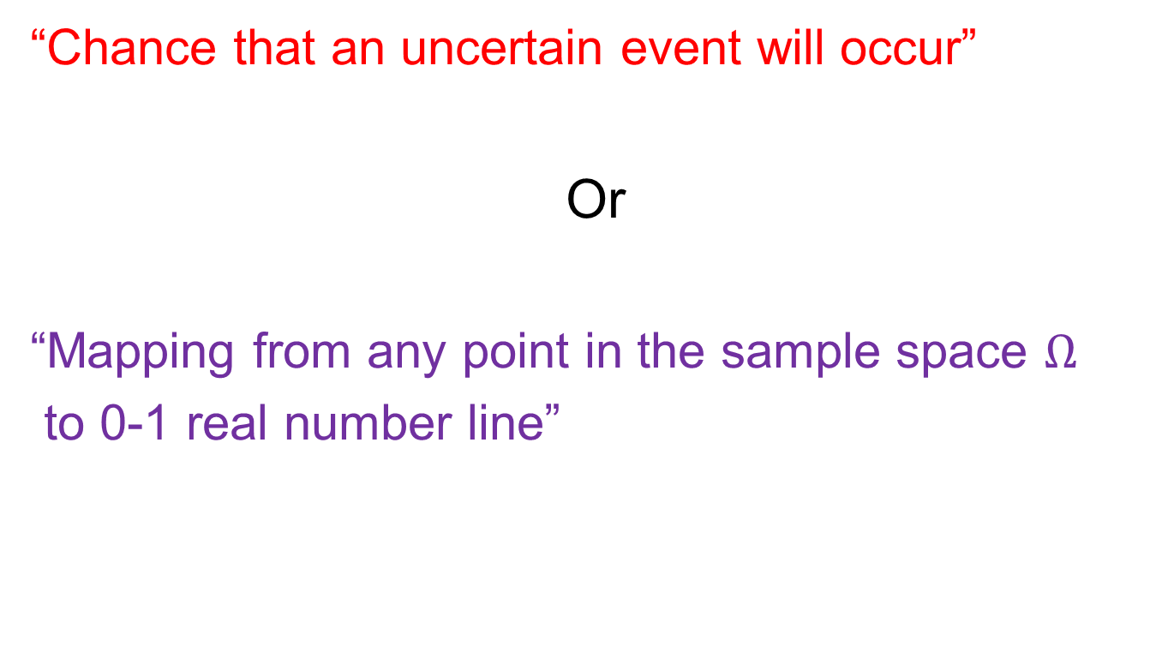
What is Probability P(x)?
“Chance that an uncertain event will occur”
Or
“Mapping from any point in the sample space $Ω$
to 0-1 real number line”

Slide 3
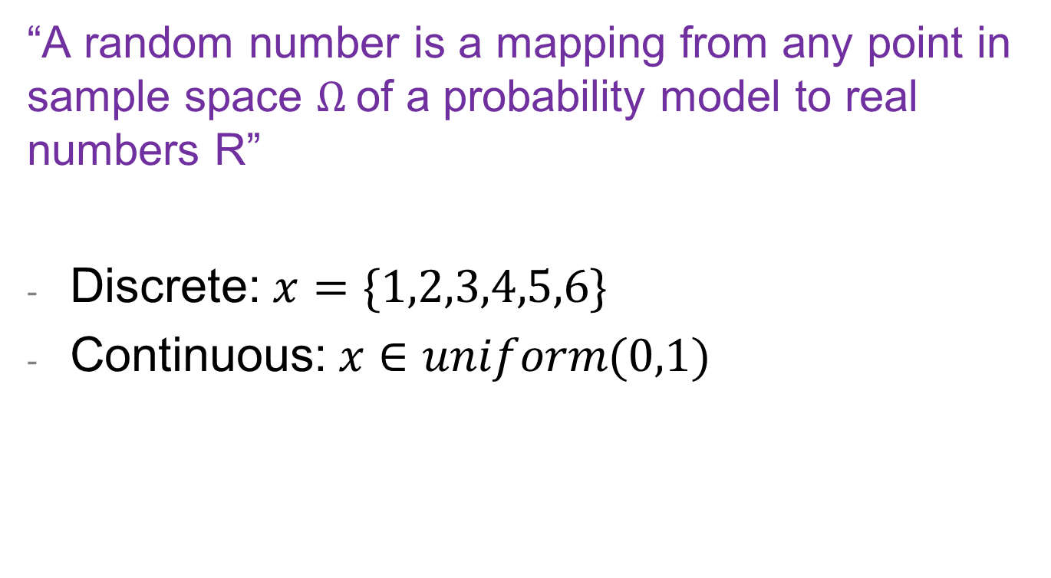
Random Numbers
“A random number is a mapping from any point in sample space $Ω$of a probability model to real numbers R”
Discrete: $x=\{1,2,3,4,5,6\}$
Continuous: $x∈uniform(0,1)$

Slide 4
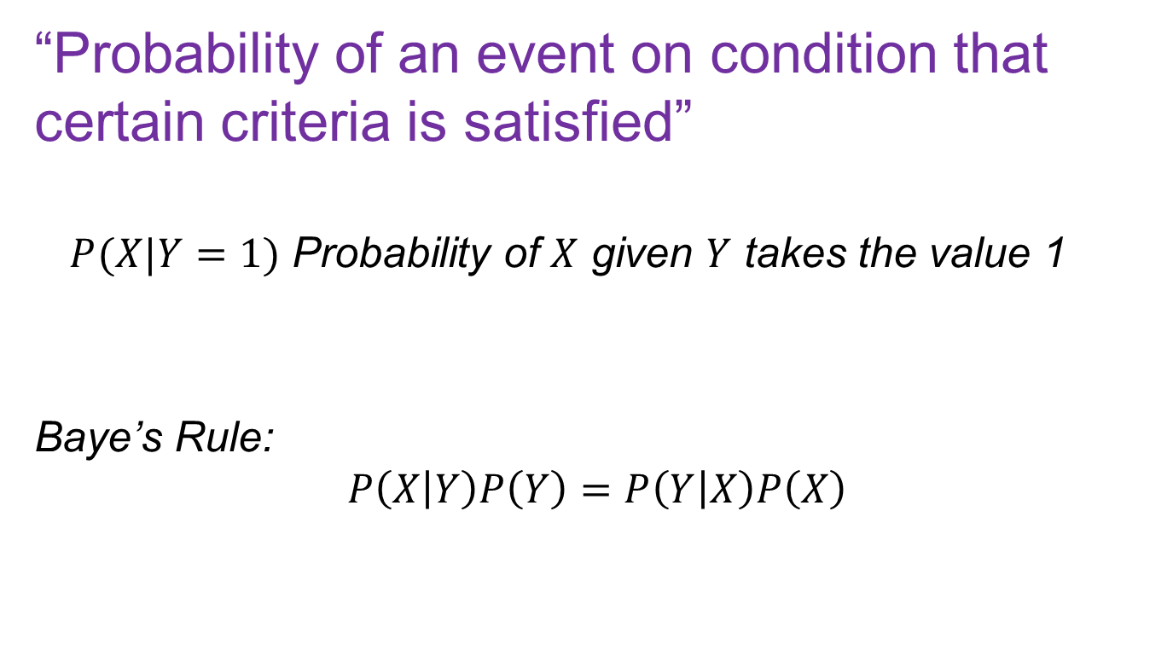
Conditioned Probability
“Probability of an event on condition that certain criteria is satisfied”
$P(X|Y=1)$ Probability of $X$ given $Y$ takes the value 1
Baye’s Rule:
$$P\left(X | Y\right)P\left(Y\right)=P\left(Y | X\right)P\left(X\right)$$

Slide 5
Probability Distributions
Discrete: Countable outcomes
Rolling a Dice
Binomial, Bernoulli, Poisson, etc.
Continuous: Infinite continuum of outcomes
Wait time in at McDonalds
Normal, Uniform, Exponential, etc.

Slide 6
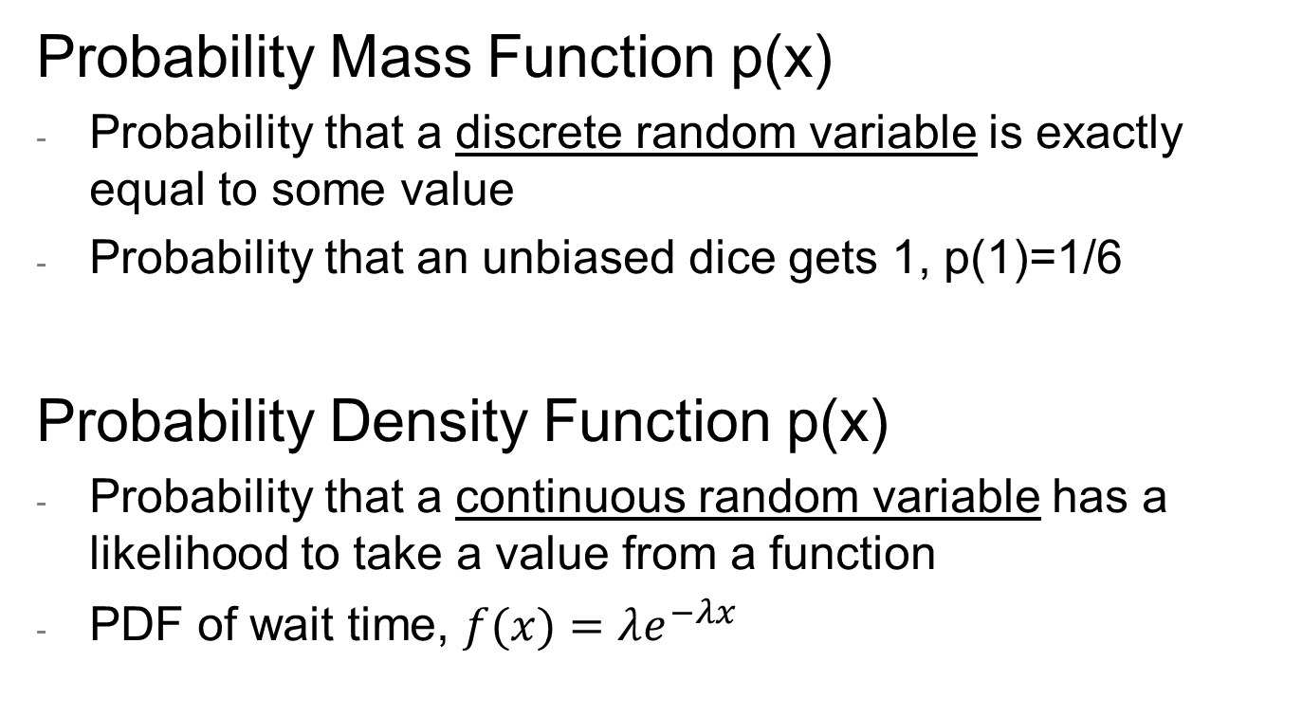
PMF vs PDF
Probability Mass Function p(x)
Probability that a discrete random variable is exactly equal to some value
Probability that an unbiased dice gets 1, p(1)=1/6
Probability Density Function p(x)
Probability that a continuous random variable has a likelihood to take a value from a function
PDF of wait time, $f(x)=λe^{−λx}$

Slide 7

Cumulative Density Function
Cumulative Density Function F(x)
Probability that a random variable X will take a value less than or equal to x, or F$\left(X≤x\right)$
For Exponential Distribution, F$\left(X≤x\right)=1−e^{−λx};x≥0$

Slide 8
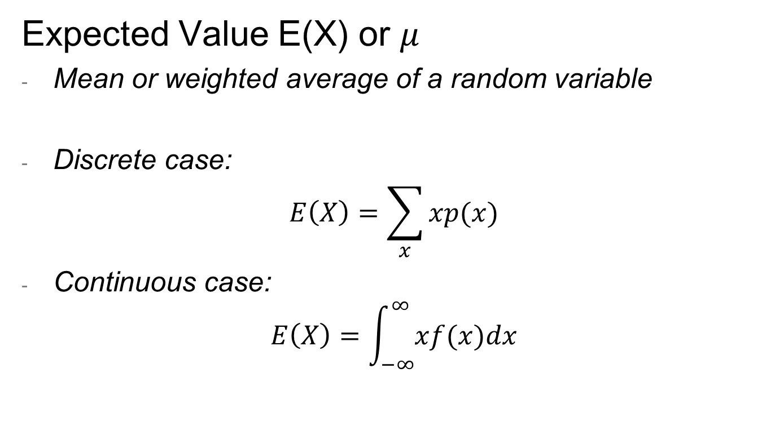
Expected Value
Expected Value E(X) or $μ$
Mean or weighted average of a random variable
Discrete case:
$$E\left(X\right)=\sum_{x}{xp(x)}$$
Continuous case:
$$E\left(X\right)=\int_{−∞}^{∞}{xf(x)dx}$$

Slide 9
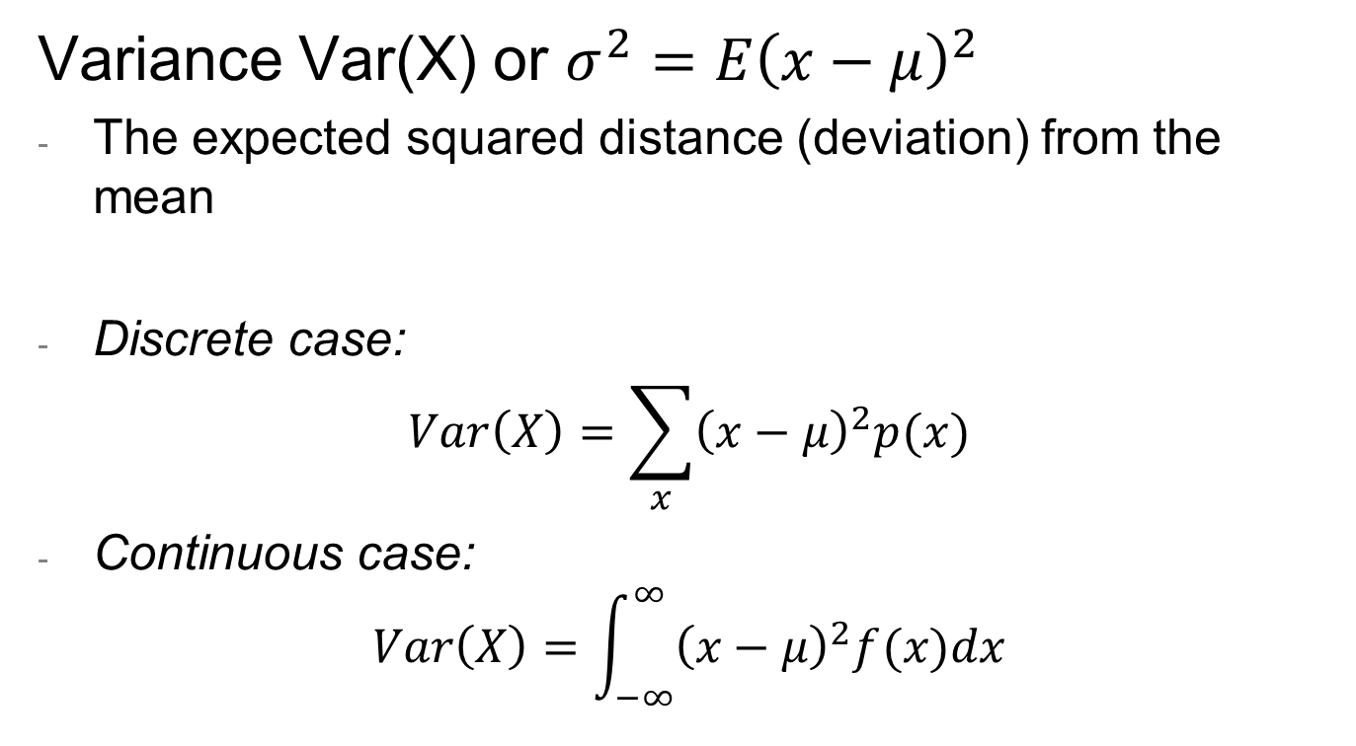
Variance
Variance Var(X) or $σ^{2}=E{\left(x−μ\right)}^{2}$
The expected squared distance (deviation) from the mean
Discrete case:
$$Var\left(X\right)=\sum_{x}{{\left(x−μ\right)}^{2}p(x)}$$
Continuous case:
$$Var\left(X\right)=\int_{−∞}^{∞}{{\left(x−μ\right)}^{2}f(x)dx}$$

Slide 10
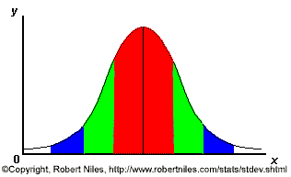
Normal Curve
One standard deviation from the mean (σ)
Mean (μ)

Slide 11
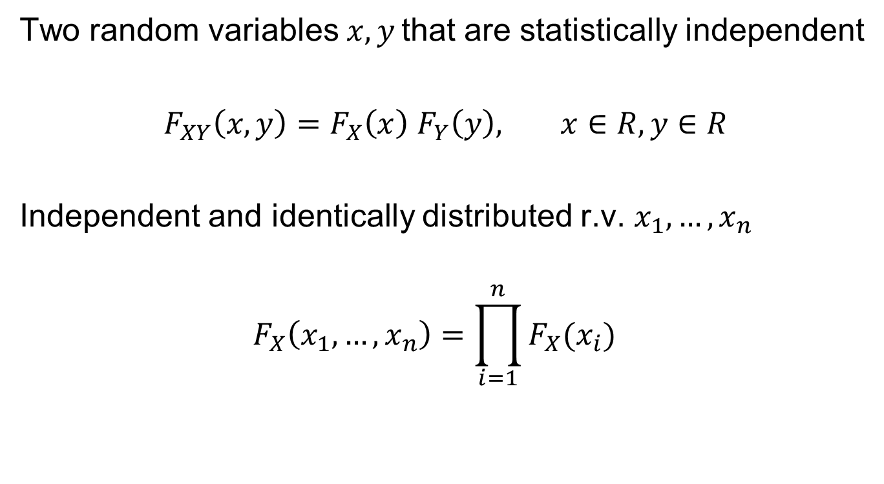
Statistical Independent Random Variables
Two random variables $x,y$ that are statistically independent
$F_{XY}\left(x,y\right)=F_{X}\left(x\right)$ $F_{Y}\left(y\right), x∈R, y∈R$
Independent and identically distributed r.v. $x_{1},…,x_{n}$
$$F_{X}\left(x_{1},…,x_{n}\right)={\prod_{i=1}^{n}{F_{X}(x_{i})}}_{}$$

